Slide 1
Freedom
​​You Must Want It!

Slide 2
Christ’s exaltation is the Purpose of my Life - Phil. 1:18-24
Exodus: Freedom Without Reward
Israel’s failure to enter the Land was not because they loved bondage – Ex. 1:13-14; 2:23-25
Israel’s failure to enter the Land was not because God’s grace on their behalf fell short.
God’s purpose and plan was for Israel’s freedom and reward of the Promised Land - Ex. 3:7-8, 10
God provided the right information – Ex. 4:1-9
God provided the right program/plan – Ex. 19:3-6

Slide 3
Christ’s exaltation is the Purpose of my Life - Phil. 1:18-24
Israel Failed to Enter the Land Because…
They did not want God’s freedom enough to receive it!
Freedom was not their true desire – Ex. 14:10-12
They refused to make the sacrifice that God’s freedom required - Ex. 20:5-8ff.; Josh. 24:14
These sentiments prevailed and cost them the Promised Land – Num. 14:1-2, 4; Lk. 9:62; Num. 14:28-30

Slide 4
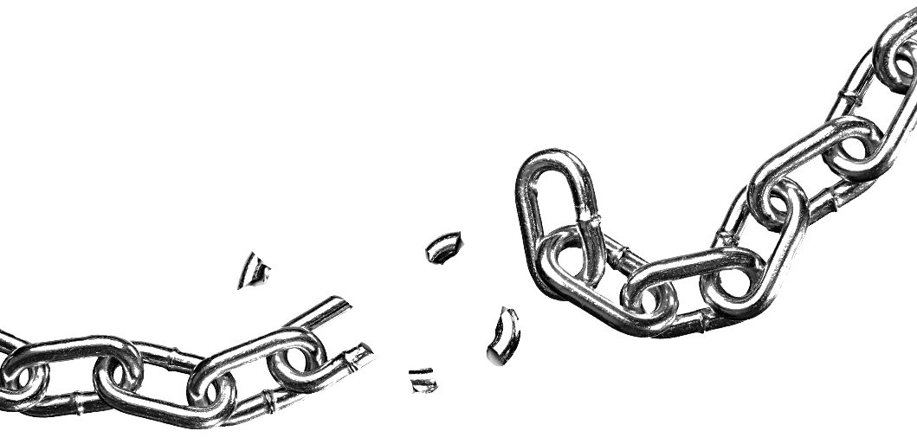
You Must Want Freedom to Receive Its Reward
God’s grace has made salvation and freedom possible – Eph. 4:4-9
Freedom produces no reward without trust and obedience – Heb. 3:16-19, 4:11
It comes down to whether we truly want freedom and its reward.
Proof? – Romans 6
Grace produces people dead to sin – 6:1-2; Jas. 2:26
Death to sin and resurrection to life come by submitting in faith to baptism – 6:3-7; Col. 2:12
This Photo by Unknown Author is licensed under CC BY-NC

Slide 5
Eternal Life Requires Wanting Freedom Enough To…
Consider yourself dead to sin and alive to God – 6:11
Refuse to submit to sin – 6:12-13a
Fully submit to God and righteousness – 6:13b; Eph. 2:10
Salvation by grace requires this way of life – 6:14-16, 20-23
This Photo by Unknown Author is licensed under CC BY-NC

