Slide 1
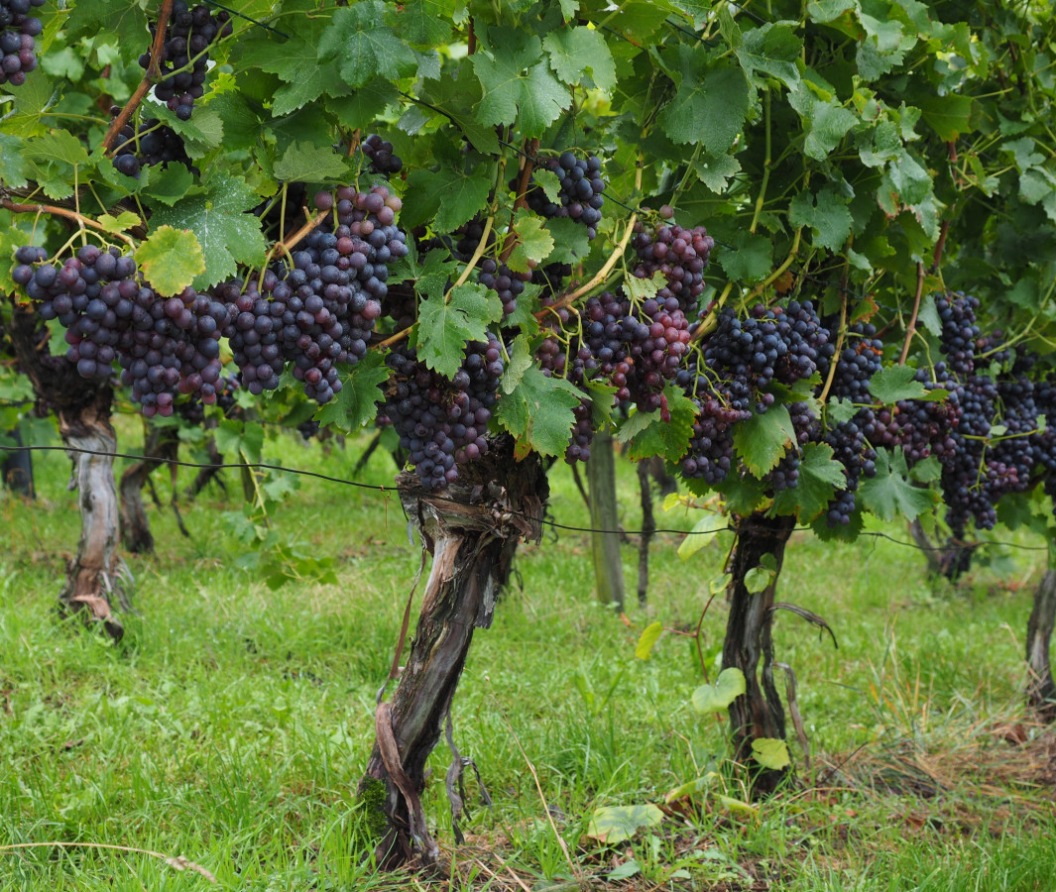
The Tales of Two Vineyards
Isaiah 5:1-7 John 15:1-10

Slide 2
A Vineyard Song of Hope and Loss
-
Isaiah 5:1-7
Sung for the beloved about his vineyard – 5:1
The beloved created it for good grapes, but received worthless ones – 5:2
A call for judgment between the beloved and his vineyard – 5:3-4
The beloved, the Lord, passes judgment on his vineyard and plant, Israel and Judah – 5:5-7

Slide 3
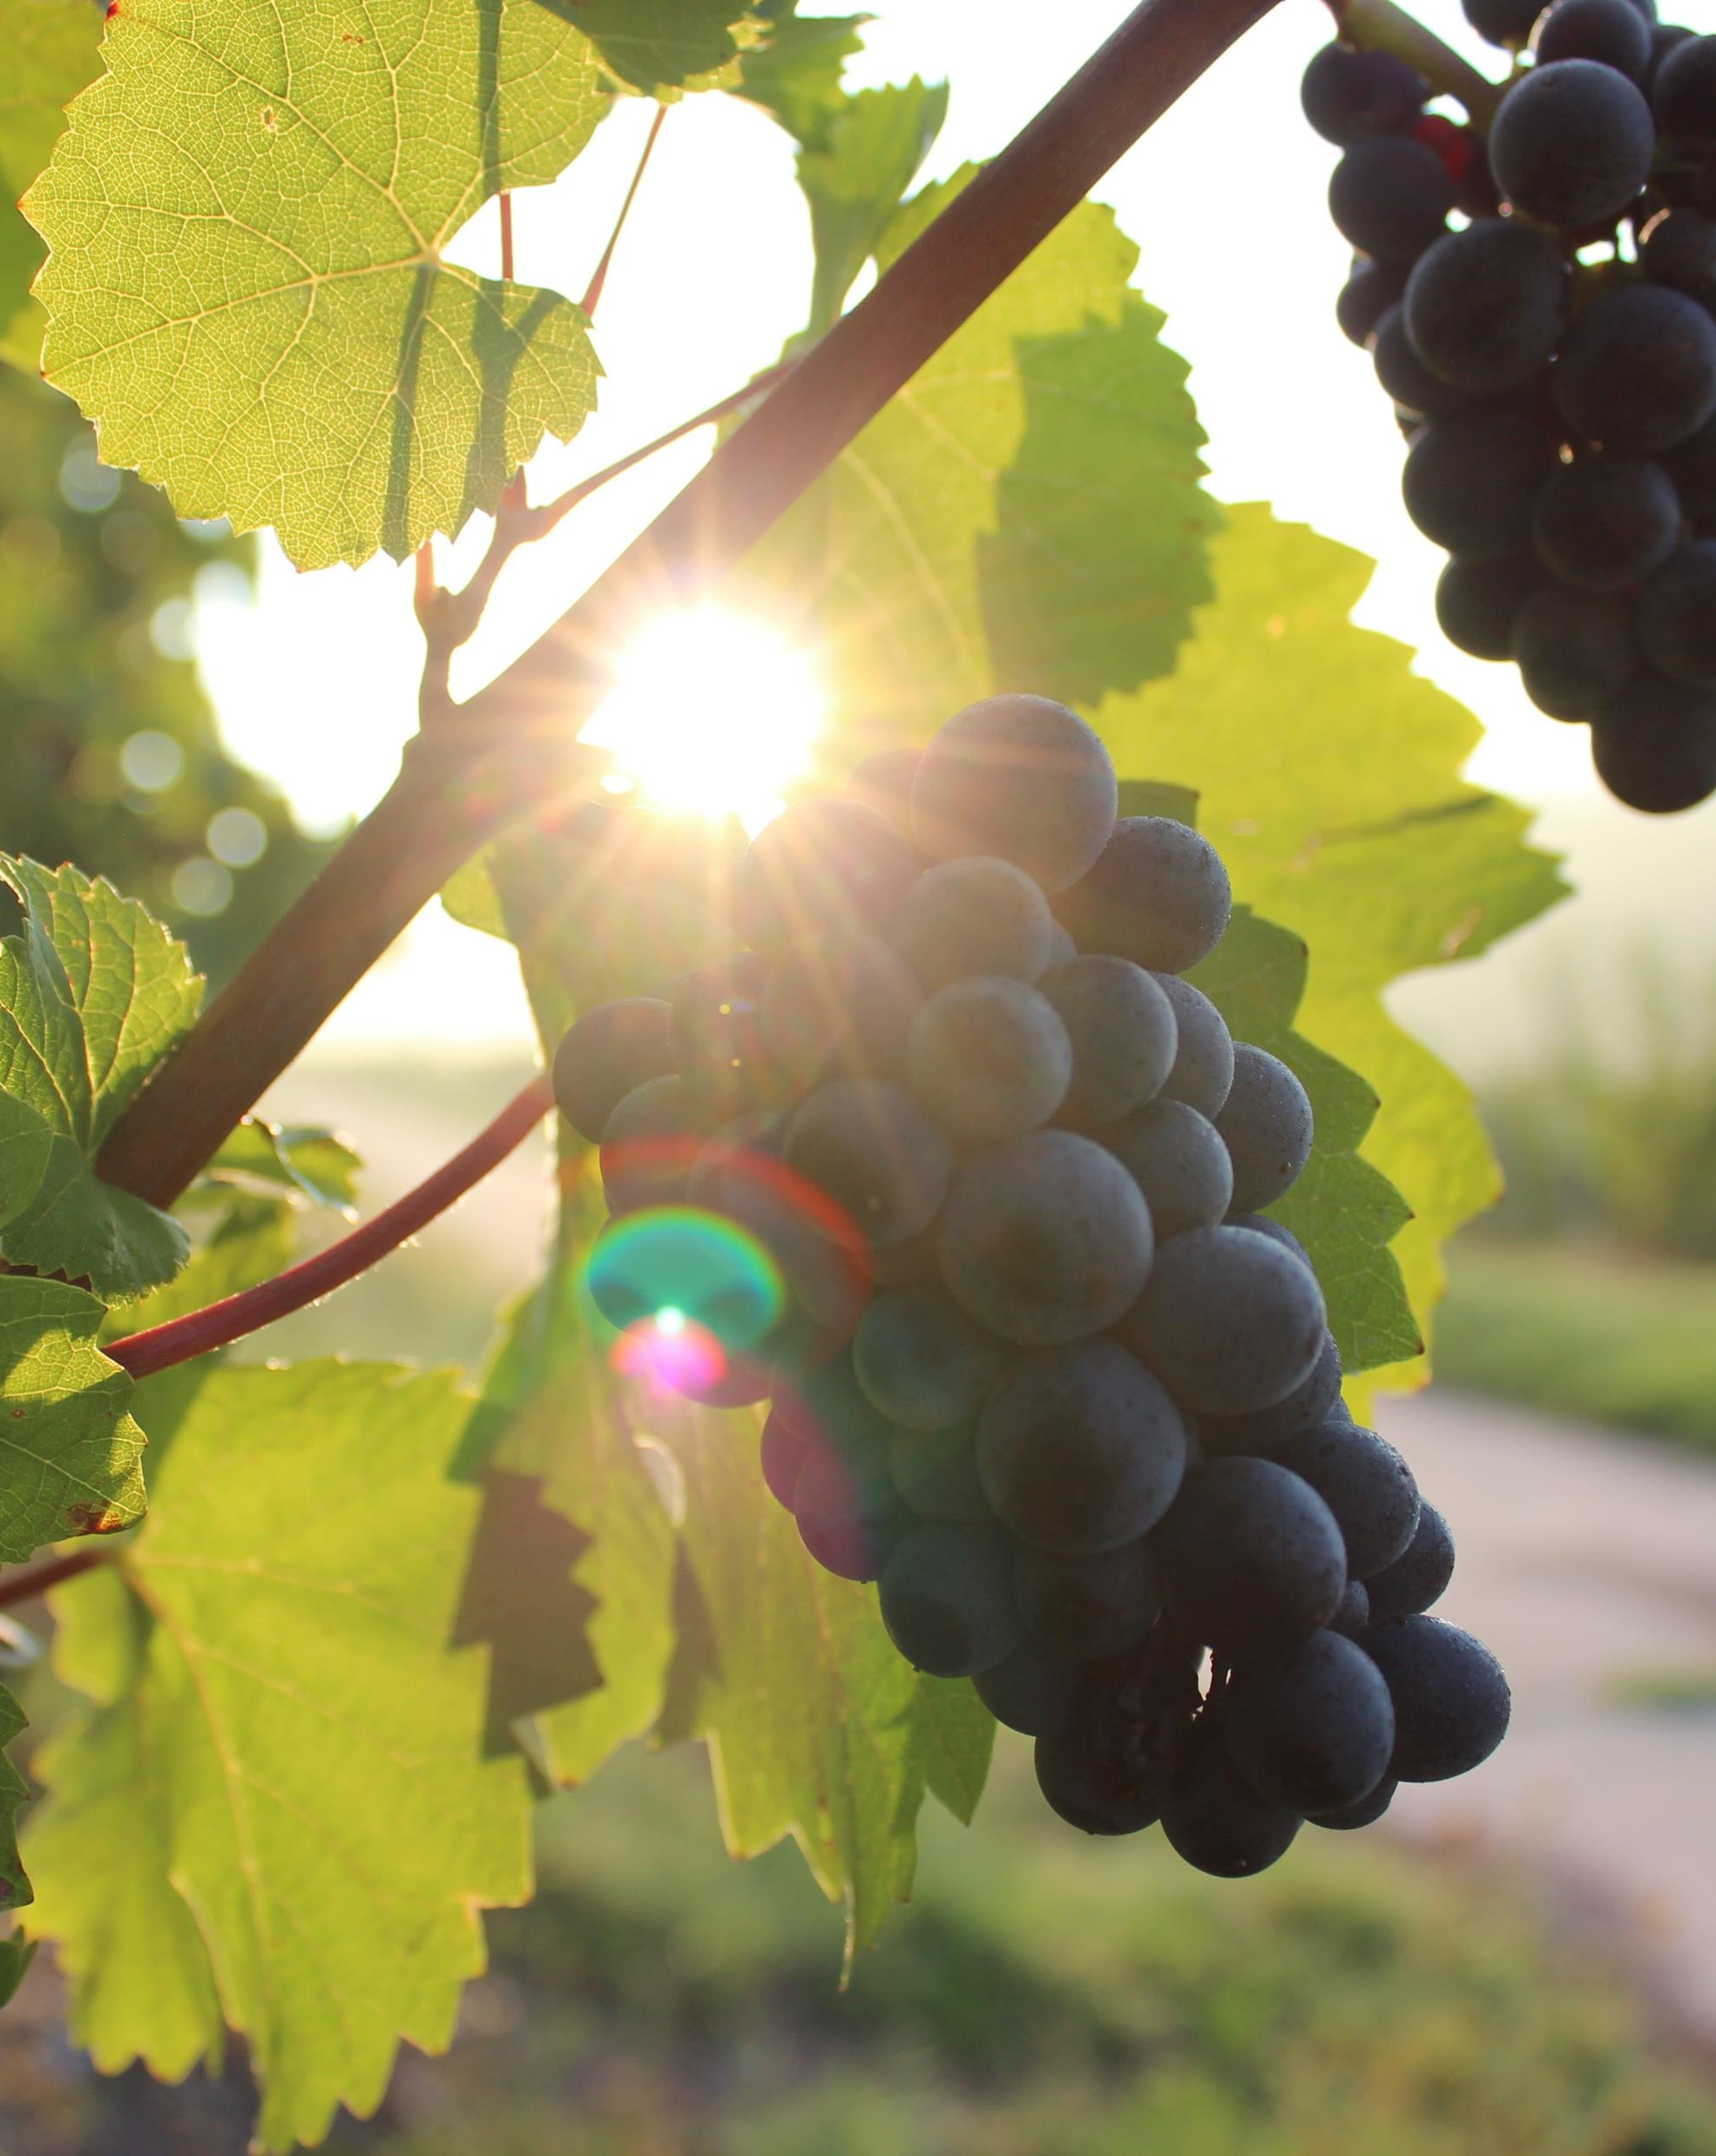
Jesus is the vine and the Father the vinedresser – 15:1; Jn. 3:16; Rom. 5:8
The vinedresser removes and prunes the branches – 15:2-3
Branches must abide in the vine – 15:4-6, 2, 10; 14:23; Heb. 5:8-9
What fruit must we bear? – Eph. 5:8-10; Rom. 1:13-14; Mt. 28:18-20; Gal. 2:20
A Parable Of God’s Vine and Branches
-
John 15:1-10

