Slide 1
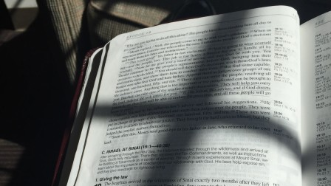
Old Testament Shadows of the Jesus
Moses
Part 3

Slide 2
Rejected Redeemers
Both were shepherds sent to redeem Israel.
Moses –Ex. 3:1-2,10; 6:7-8
Jesus – Jn. 10:10; 14-17; 8:31-36
Both were rejected as redeemers
Moses – Acts 7:22-27; Ex. 5:1-2, 20-23
Jesus – Jn. 1:9-11; 7:11-2; 12:37-38; Isa. 53:1-12
Jesus is a greater redeemer by entering the world He created with full knowledge of His rejection, suffering, and death to bring redemption and life.

Slide 3
Intercessors
Moses the intercessor – Ex. 32
When Moses was with God on Mt. Sinai he was sent down because of Israel’s sin – Ex. 32:7-14
On seeing their sin Moses returned to God to intercede and make atonement – Ex. 32:30-35; Num. 20:9-12; 27:12-14; Heb. 3:16-19
Jesus the intercessor
Jesus was with God when He was sent down to earth because of His people’s sin – 1 Jn. 4:9-10
He came as one of us, as one of our brethren – Heb. 2:14-18
Jesus’s intercessory role was tested – Mt. 4:8-11
Jesus sought to provide atonement for our sins…and did! – Heb. 2:17; 1 Jn. 2:1-2; Heb. 7:23-25
Jesus is an infinitely greater intercessor in every way!

