Slide 1
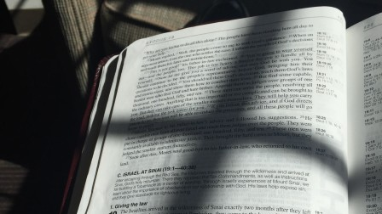
Old Testament Shadows of the Jesus
Moses

Slide 2
Moses – An Important Shadow of Jesus
Though Moses was great and his shadow signficant, Jesus is shown to be far greater – Heb. 3:1-6
Prophesied by Moses over 1400 years before it was to be fulfilled! – Deut. 18:15, 17-19
Why this prophecy if not by inspiration?
Its value is as a marker by which to identify the Messiah – Acts 3:11-26

Slide 3
Birth and Early Life
SHADOW
Moses was born when Israelites were being oppressed under foreign rule – Ex. 1:13-14
He was born when a king wanted to kill him – Ex. 1:15-16, 22
Moses was hidden, adopted by Pharaoh’s daughter, and given a special name – Ex. 2:1-6, 10

Slide 4
Jesus
S
U
B
S
T
A
N
C
E
Born when Israel was under foreign rule and oppressed by their sin – Jn. 8:31-33ff.
Adopted and given a special name – Mt. 1:20-25; Lk. 3:23
Born when a king wanted to kill him – Mt. 2:1-3, 16
Hidden by His parents in Egypt – Mt. 2:13-15; Hos. 11:1
Jesus is greater in name and reason for adoption and for leaving Egypt

Slide 5
Humility
SHADOW
Though Moses had great honor/power, his choice to deliver Israel required humility
Though Moses’ humility was great (Num. 12:3), it was learned by circumstance – Acts 7:23-25; Ex. 2:11-12, 15
These circumstances forced upon him were the results of Moses’ great faith – Heb. 11:24-27

Slide 6
Jesus
S
U
B
S
T
A
N
C
E
Though Jesus posessed great honor/power, His choice to deliver mankind required humility
Jesus’ humility was by choice – Phil. 2:5-8
Jesus is greater in humility and purpose of that humility

Slide 7
Preparation for Ministry
SHADOW
After leaving Egypt, Moses spent a great portion of His life as a lowly shepherd in the wilderness of Midian – Ex. 2:15, 3:1; Gen. 46:33
After forty years, God appeared there to Moses and commissioned him to return to Egypt to free the Israelites – Acts 7:30-34

Slide 8
Jesus
S
U
B
S
T
A
N
C
E
After leaving Egypt, Jesus spent thirty years in Nazareth as a lowly carpenter – Mk. 6:1-3; Lk. 3:23
In final preparation, Jesus spent forty days and nights in the wilderness being tempted by the devil – Mt. 4:1-3ff.
Jesus is greater in facing the fullness of Satan’s temptation without sinning to become our High Priest – Mt. 4:3-11; Heb. 4:14-16

