Slide 1
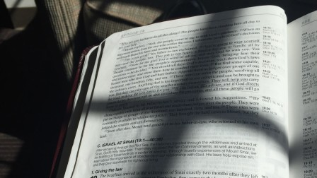
Old Testament Shadows of the Christ
Melchizedek

Slide 2
Why Is The Melchizedek Shadow Important?
The Messiah was prophesied to be king and priest of God
He would be a “branch” from the stem of Jesse – Isa. 11:1-9ff.
He would reign on David’s throne – Isa. 9:6-7
This “Branch” would serve as priest while on the throne – Zech. 6:11-13
This king and priest Messiah created a problem!
To be a branch from Jesse and rule on David’s throne meant he had to be of the tribe of Judah.
Levi, not Judah, was the priestly tribe.
How could this be? Was their precedence? What would happen to the Law?

Slide 3
Melchizedek
SHADOW
He appears after Abraham defeats of the four kings – Gen. 14:17-20
He was king of righteousness and of peace.
He was priest of God Most High.
Abraham acknowledged his exalted position by receiving his blessing and giving him 10th of the spoils.
David prophesied of the Messianic king and priest of the order of Melchizedek – Psa. 110:1-2, 4
The Messiah is Lord and would rule at God’s right hand – 110:1
God gave an unchanging oath that He would be a priest forever after the order of Melchizedek – 110:4

Slide 4
Jesus
S
U
B
S
T
A
N
C
E
Jesus fulfilled the role of king – Heb. 7:1-2; Lk. 1:30-33; Acts 2:32-36; Psa. 110:1-4
Jesus fulfills the role of eternal High Priest – Heb. 6:19-20; 7:3; Heb. 7:15-17

Slide 5
Melchizedek
QUESTIONS
Answers Jesus being of the tribe of Judah – Heb. 7:3; Gen. 14; Psa. 110:1-4
Answers how Christ’s priesthood could be greater than the Levitical – Heb. 7:4-10
Answers whether the Law could stop Jesus from being a priest – Heb. 7:11-14
Answers why Jesus offers a greater, more steadfast, and sure hope – Heb. 7:15-25

