Slide 1
Opening our eyes
Seeing Life Through God’s Eyes

Slide 2
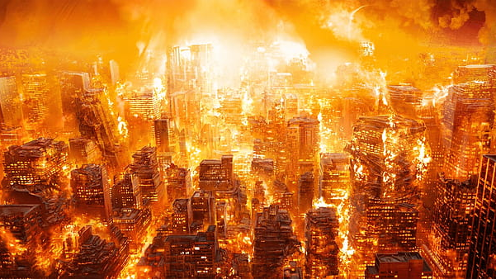
Open Our Eyes to the World’s Condition
We must see the world as God sees it—a world destroying itself in sin
Adam and Eve – Gen. 3:1-19; Rom. 5:12
The flood of Noah’s day – Gen. 6:5-8; 7:17, 20-21
Sodom and Gomorrah – Gen. 13:13; 19:24-25; Jude 7
Our world has filled itself with sin
The guilt of sin applies to all – Rom. 3:9, 23; Rom. 1:18-20
Do we think God will respond differently to sin today? – Rom. 6:23; 2 Thess. 1:7-9; Rev. 21:6-8
I must ask myself how I can sit by and do nothing!

Slide 3
Open our Eyes to the Value of a Soul
A soul is invaluable – Mt. 16:24-26
I have found this difficult for the world to see.
I have found this difficult for Christians to see – Mt. 7:16, 20
We must open our eyes to the value of a lost soul!
God values souls enough to send Jesus to die – Rom. 5:6-8
Jesus valued souls enough to leave heaven and die on the cross – Phil. 2:6-8

Slide 4
Open Our Eyes to the Work Before Us
We must be like our Master! – Matt. 10:24-25
Jesus came to “seek and save the lost” – Lk. 19:10
To be like Christ we must seek the lost to reconcile them to God – 2 Cor. 5:17-19
We must open our eyes to the “harvest” of souls before us
The fields are ripe for harvest now – Jn. 4:34-36
Now is the time of salvation for all – 2 Cor. 6:1-2
It is time to shine Christ’s light to the world by our deeds and words – Matt. 5:14-16
We cannot afford to wait for a more convenient time – Mt. 9:36-38

