Slide 1
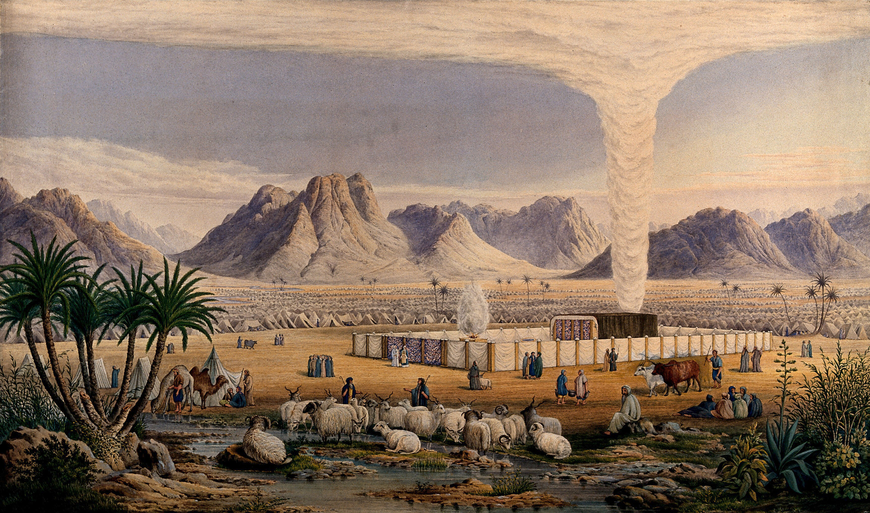
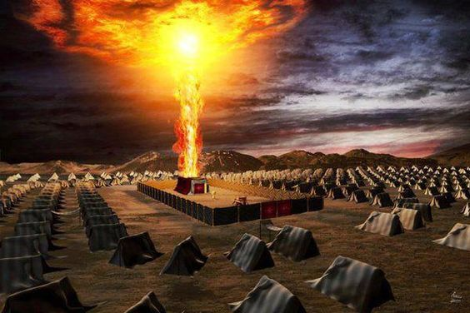
Israel and the Cloud and Fire
A Study of Divine Authority from Numbers 9:15-23
This Photo by Unknown Author is licensed under CC BY-ND

Slide 2
Israel’s Journey and the Cloud
Israel’s journey was directly connected to God’s cloud
They moved when the cloud move and stayed when it stayed – 9:17
This was by God’s will – 9:18a; Heb. 11:8
Our journey is directly connected to God’s word
The word is the expression of God’s authority for us today – 1 Cor. 14:37
The written word directs our way today – 1 Tim. 3:14-15; 2 Tim. 3:16-17
Our role is to trust God’s authoritative word and obey – Heb. 5:8-9

Slide 3
If the Cloud Stayed, Israel Stayed
This was done by the Lord’s charge – 9:18b-20
It did not matter how long the cloud stayed.
It did not matter how difficult it might be.
Some Jews became frustrated with the pace, believing they should move forward more quickly to the Land.
The lingering cloud means missing out, monotony, restlessness, boredom, and disconnection
They move on with the cloud at their backs and sure of their decision!
Their departure caused them to 1) leave God’s will behind, 2) rejects God’s timetable – 9:20, and 3) forsake God’s compassionate guidance – Neh. 9:19

Slide 4
Our Journey Requires Staying Where The Lord Says Stay
God stays with those who stay within Christ’s teaching – 2 Jn. 9
God’s people are limited to what is revealed in the word.
Israel – Deut. 29:29
Christians – 1 Cor. 4:6
People will defend their additions as helping God’s cause to move forward.
This is claimed of changing the divine organization and work of the church.
If it is not found in the written word, it is not of God, is disobedience, and will cause one to perish!

Slide 5
Israel Moved Whenever the Cloud Moved
Israel moved even if their stay was short – 9:20-21
Some Jews are concerned about how moving on too quickly might be overly difficult for some, and they decide to stay.
Despite their seemingly legitimate concerns, their choice to stay behind:
Meant God’s presence and guidance went on without them, dooming them to wandering helplessly and hopelessly.
Showed a complete lack of faith in God’s concern for His people and His ability to lead His people as they should go!
Defied God’s authority – 9:22-23
Caused them to perish!

Slide 6
Our Journey Requires Moving When God Says to Move
If God says to move and we sit, we sin – Jas. 4:17
Jesus never said the journey would be easy – Mt. 10:38-39; 7:13-14
It is not our role to lighten the Lord’s conditions or demands:
To make the way easier for God’s people (i.e., no withdrawal, no preaching the hard truth, no rebuking sin, etc.)
To make the gospel more palatable for the masses (i.e., less preaching and more recreation, do not stress repentance, etc.)
To do so is to show a lack of faith in Christ, to defy His authority, and to perish!

