Slide 1
We must Change to be changed
​​Changing Our Minds About Sin and Freedom

Slide 2
Christ’s exaltation is the Purpose of my Life - Phil. 1:18-24
Israel was not content in their bondage – Ex. 2:23-25
God’s grace redeemed them – Ezek. 20:5-9
Though Israel went along with freedom, they failed to change their bondage mindset.
The failed to appreciate God’s power, dominance over Egypt/Pharoah, and what it meant for them.
When trials arose, they reverted to the bondage mindset – Ex. 14, 15, 16, 17, 32; Num. 11
Their failure to change their minds cost them the Promised Land – Num. 14:1-4; 14:26-32
Israel’s Bondage Mindset

Slide 3
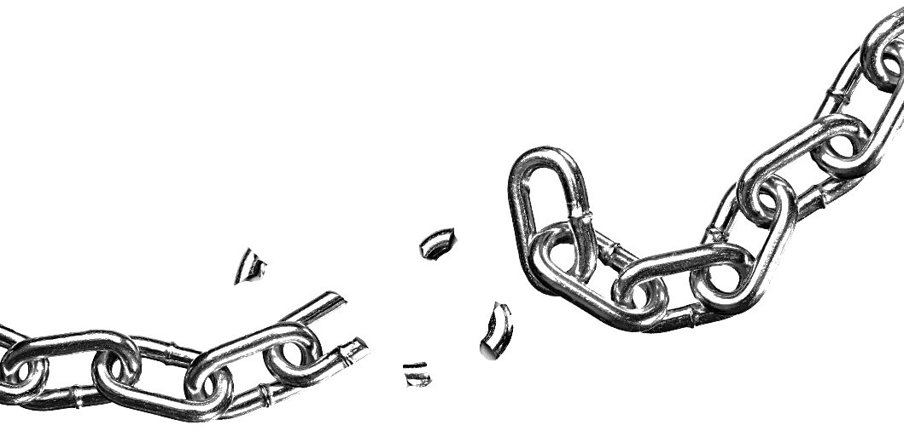
Christians Have A Freedom Mindset - Romans 6
The saved have died to the old way of sin – Rom. 6:1-2
The saved have been raised with Christ through baptism to freedom from sin – Rom. 6:3-7
The saved must believe in that freedom and live like it – Rom. 6:11-14
This Photo by Unknown Author is licensed under CC BY-NC

Slide 4
Choose Freedom!
Romans 6:20-23
This Photo by Unknown Author is licensed under CC BY-NC

