Slide 1
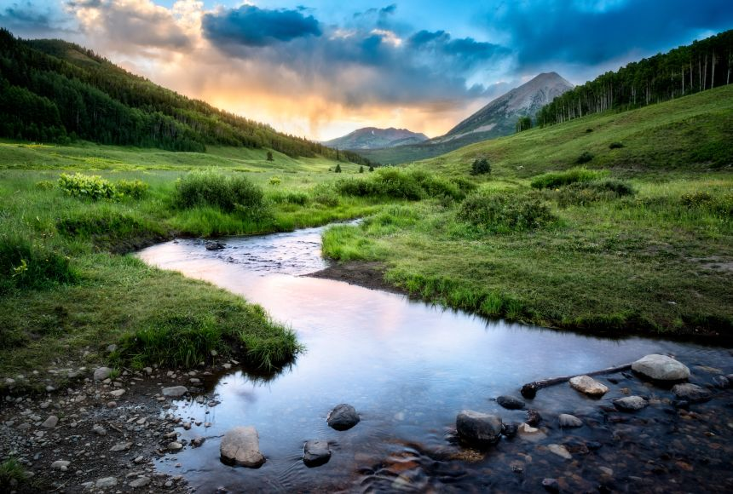
Streams of Grace
Part 1: Connecting With Jesus

Slide 2
Bartimaeus Luke 18:35-43
³⁵ As Jesus was approaching Jericho, a blind man was sitting by the road begging. ³⁶ Now hearing a crowd going by, he began to inquire what this was. ³⁷ They told him that Jesus of Nazareth was passing by. ³⁸ And he called out, saying, “Jesus, Son of David, have mercy on me!” ³⁹ Those who led the way were sternly telling him to be quiet; but he kept crying out all the more, “Son of David, have mercy on me!” ⁴⁰ And Jesus stopped and commanded that he be brought to Him; and when he came near, He questioned him, ⁴¹ “What do you want Me to do for you?” And he said, “Lord, I want to regain my sight!” ⁴² And Jesus said to him, “Receive your sight; your faith has made you well.” ⁴³ Immediately he regained his sight and began following Him, glorifying God; and when all the people saw it, they gave praise to God.

Slide 3
Zaccheus Luke 19:1-10
​¹ He entered Jericho and was passing through. ² And there was a man called by the name of Zaccheus; he was a chief tax collector and he was rich. ³ Zaccheus was trying to see who Jesus was, and was unable because of the crowd, for he was small in stature. ⁴ So he ran on ahead and climbed up into a sycamore tree in order to see Him, for He was about to pass through that way. ⁵ When Jesus came to the place, He looked up and said to him, “Zaccheus, hurry and come down, for today I must stay at your house.” ⁶ And he hurried and came down and received Him gladly. ⁷ When they saw it, they all began to grumble, saying, “He has gone to be the guest of a man who is a sinner.” ⁸ Zaccheus stopped and said to the Lord, “Behold, Lord, half of my possessions I will give to the poor, and if I have defrauded anyone of anything, I will give back four times as much.” ⁹ And Jesus said to him, “Today salvation has come to this house, because he, too, is a son of Abraham. ¹⁰ For the Son of Man has come to seek and to save that which was lost.”

Slide 4
Their Differences
Physical differences:
Bartimaeus was blind – Lk. 18:35
Zaccheus was small in stature – Lk. 19:3
Socio-economic differences:
Bartimaeus was forced to be a beggar – Lk. 18:35
Zaccheus was a chief tax collector and was rich – Lk. 19:2
Both were received by Jesus and experienced God’s stream of grace! – Isa. 35:1-2, 5-6; Mt. 11:28-30; 1 Tim. 2:3-6

Slide 5
Their Similarities
Their limitations did not keep them from Jesus – Lk. 18:38; 19:4; Mt. 5:6
There was urgency in their efforts to connect with Jesus - Lk. 18:39; 19:4, 5-7; Acts 2:36-38, 41; Rom. 13:11-14
They showed true humility in seeking Jesus – Lk. 18:38-41; 19:8; Lev. 5:4
They experienced the flow of God’s grace – Lk. 18:42-43; 19:9-10; Eph. 2:1-7

