Slide 1
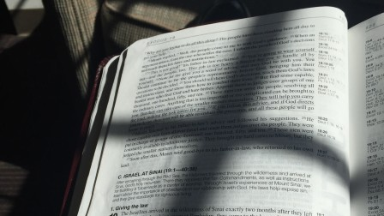
Old Testament Shadows of the Jesus
Moses
Part 2

Slide 2
Unlikely Leaders
They renounced their glorious lives for lowly ones before leading God’s people.
Moses – Heb. 11:24-26; Ex. 3:11
Jesus – Phil. 2:6-8, Lk. 19:10
They were called to lead in times of oppression
Moses – Ex. 3:7, 9-10
Jesus – Isa. 9:1-4; Matt. 4:12-17; Heb. 2:14-15
Jesus is greater leader in renouncing heaven’s glory and taking human form and breaking the bonds of sin and death!

Slide 3
Ministries and Miracles
Their ministries began with divine, miraculous affirmation.
Moses – Ex. 3:1-3ff.
Jesus – Matt. 3:16-17
Their ministries were confirmed by miracles
Moses – Ex. 4:1-5ff.
Jesus – Matt. 4:23-24; Lk. 17:11-14ff.; Jn. 2:1-11; Mt. 14:25-27; 4:24; Rev. 12:9-11; Jn. 20:30-31
Jesus is greater, being confirmed as God’s Christ and His beloved Son, and by healing all diseases, and by having power and victory over the serpent, Satan himself!

Slide 4
Lawgivers
Moses gave Israel God’s Law – Ex. 24:12; Deut. 18:15-19
God spoke to him face to face and showed him God’s form – Num. 12:6-9
His law was binding – Heb. 10:28
Jesus gave the world God’s law – Jn. 12:47-50
Jesus has seen the Father and has shown us the Father – Jn. 6:46; 14:8-9
His law was binding – Heb. 2:1-4; 10:26-31
Jesus is greater lawgiver in bringing the fullness of grace and truth (Jn. 1:17), in speaking for God as His Son and the Creator, and in providing propitiation for sin – Heb. 1:1-4

