Slide 1
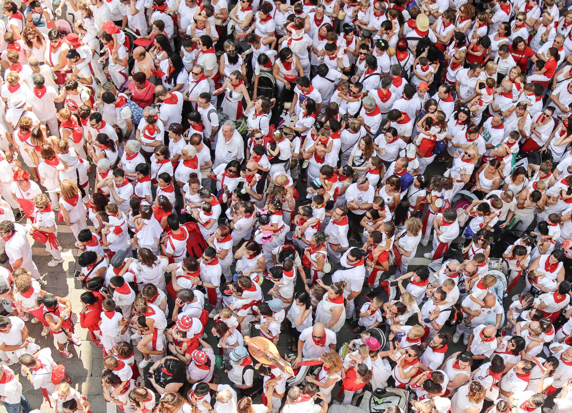
What God sees in Us

Slide 2
What God sees in All People
Someone to Love
Created in God’s image – Gen. 1:24-27
Gave us special blessings – Gen. 1:26, 28-29; 2:8-9, 18
Continuous care to the righteous and unrighteous – Mt. 5:44-45

Slide 3
What God sees in All People
Someone “Unlovable”
Rejected by Adam and Eve – Gen. 3:2-6
Rejected by the world in Noah’s day – Gen. 6:5-6, 12
Rejected by the world today – Jn. 14:15; Rom. 3:23; 5:12

Slide 4
What God sees in All People
Someone Worth Dying For
Defies all human reasoning! – Rom. 5:7
Jesus died for ungodly sinners – Rom. 5:6-10

Slide 5
What God sees in His People
Someone Who Has Left Sin and Death
They have heeded the gospel call – 2 Thess. 2:13-14; Rom. 10:17; 2 Thess. 1:6-8
They are washed, sanctified, and justified – 1 Cor. 6:9-11; Acts 22:16
They are forgiven through the blood of Christ – Rom. 3:23-26; Eph. 1:7-8; Col. 2:11-13

Slide 6
What God sees in His People
Someone Raised to Newness of Life
They are raised with Christ in baptism to walk in newness of life – Rom. 6:1-4
They live a changed life – Rom. 6:15-19
God sees His people as for what they are—new and different – 1 Pet. 1:13-19; 2 Cor. 5:17

