Slide 1
Finding Satisfaction

Slide 2
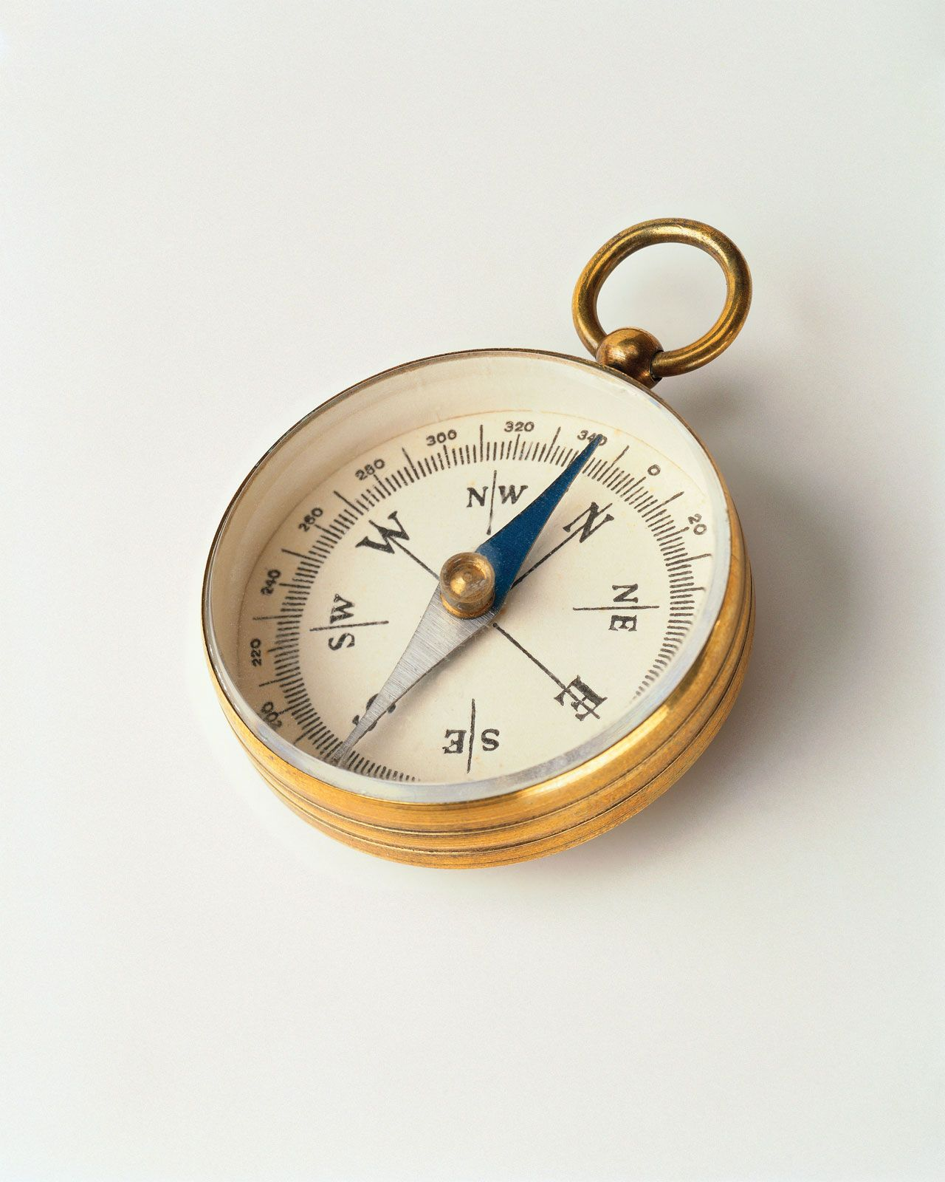
Satisfaction
Synonyms – happiness, fulfillment, contentment
To be pleased/happy because you got what you wanted, or something happened the way that you wanted
To be persuaded by argument or evidence
Being paid in full

Slide 3
You Got What You wanted
Worldly satisfaction is offered through “stuff”
Pew Research Center – In 2011 56% of Americans had a high income while 88% were wealthy by the world’s standard
US Census Bureau and givewhatwecan.org – US median/middle income of $70,784 is top 4% in the world
2022 Credit Suisse Global Wealth Report – ½ US citizens in top 13%
Has “stuff” brought us satisfaction?
Forbes (Mar. 2020) – “The World Happiness Report” ranked the US 18th out of 156 nation, down 7 spots since 2010
Lack of satisfaction is seen in alarming rate of depression and suicide
Satisfaction

Slide 4
Fame?
Tom Brady – Retired NFL quarterback with net worth of $530 million
At 23 he led the NE Patriots to a Super Bowl Title and at 24 signed a $29.6 million contract
At age 28 he became a household name, signed a $42.8 million contract and had at least 3 Super Bowl rings
Did this satisfy?
At age 27: “Why do I have three Super Bowl rings, and still think there’s something greater out there for me? I mean, maybe a lot of people would say, ‘Hey man, this is what is. I reached my goal, my dream, my life. Me, I think…it’s gotta be more than this. I mean this can’t be what it’s all cracked up to be. I mean I’ve done it. I’m 27. And what else is there for me?”
I do not think he has found it yet.

Slide 5
fame?
Jim Carrey – Actor, comedian, net worth 180 million
Fame made him the highest paid Hollywood actor
Between 1996 and 2014 he starred in 9 movies resulting in a total salary of $182 million
His fame has earned him $300 million and his movies have grossed almost $4.9 billion worldwide.
Did it bring satisfaction?
In 2017 Carrey stated: “I think everybody should get rich and famous and do everything they ever dreamed of so they can see that it’s not the answer.
It seems he has not yet found it.

Slide 6
Being persuaded by the evidence
This definition plays a significant role in whether we achieve satisfaction.
Biblical arguments and evidence
Jesus – Money and possessions are easily lost, will perish, and cannot satisfy – Mt. 6:19-20; Jn. 6:26-27; Lk. 12:15
Holy Spirit – Warns of the peril of a materialistic path – 1 Jn. 2:15-17; 1 Tim. 6:6-12
Satisfaction

Slide 7
fame?
Solomon – King of Israel, possessor of exceptional wisdom, knowledge, riches, and honor – 2 Chron. 1:8-13
He sought to enjoy all the things this world offers and judged them by his wisdom – Eccl. 2:1-10
Did power, greatness, wealth, pleasure, etc., bring satisfaction?
It was all vanity—it does not satisfy – Eccl. 2:11; 5:10; 6:7; Prov. 27:20
Man’s only worthy pursuit for life and satisfaction is God – Eccl. 12:13-14

Slide 8
Being Pain in full
Satisfaction in Christ has nothing to do with our being “paid in full.”
What God provides is a gift – Isa. 55:1-3; Rev. 12:6-7; Rom. 3:23-24
Though undeserved, God provides lasting fullness beyond measure – Psa. 16:11; Jn. 6:35; 8:12
If you seek money, wealth, and pleasure, you will be “paid in full.”
Sin pays in “wages” – Rom. 6:21, 23
You will receive “payment in full” – 2 Thess. 1:7-8; Rev. 21:8
Satisfaction

