Slide 1
Jacob’s Forgotten Vow
Genesis 35:1-7

Slide 2
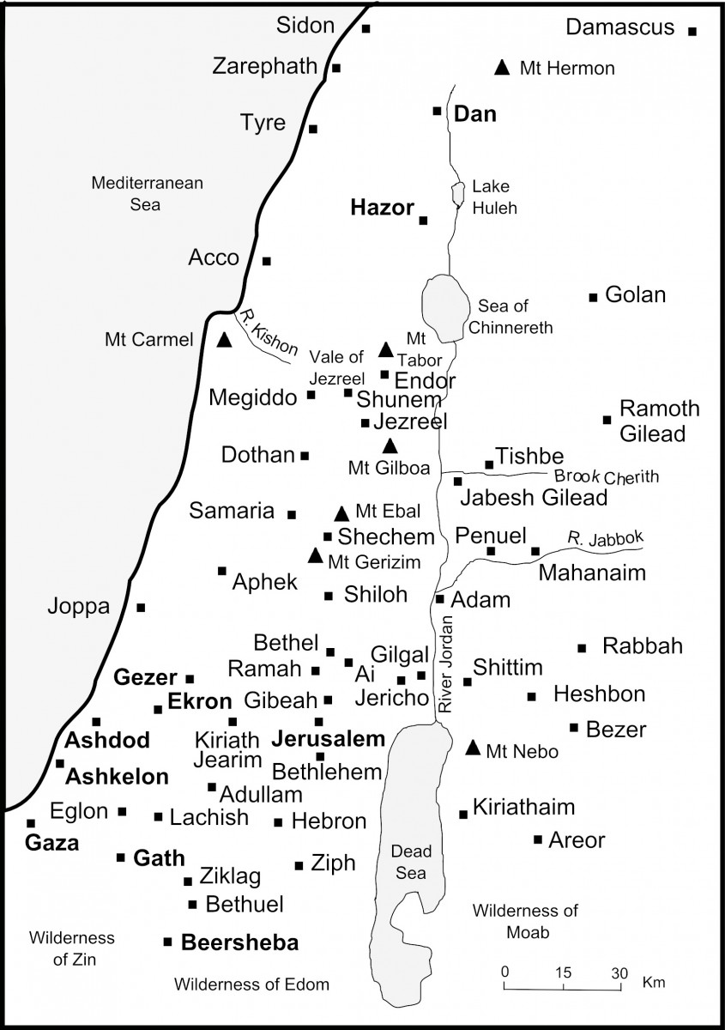
Historical background
Thirty years earlier Jacob had the “ladder” dream where God promised to be with him.
The dream prompted Jacob to vow...
To make the Lord his God
His stone pillow set as a pillar would be God’s house
To give back a tenth of all that God gave him
For 20 years Jacob lived a blessed life in Haran and then returned home safely – Gen. 30-33
By Gen. 35, Jacob had been living in Shechem of Canaan for 10 years – Gen. 33:18
Genesis 28:10-22

Slide 3
Application

Slide 4
Remembering our vows is important Because...
God expects us to do so – Eccl. 5:4-5

Slide 5
Remembering our vows is important Because...
We are prone to forget them after God has fulfilled His side

Slide 6
Remembering our vows is important Because...
We are prone to forget them when things are going well – Deut. 8:11-14, 18-19

Slide 7
Remembering our vows is important Because...
Forgetting our vows results in being influenced by the world – Ex. 20:2-6; Gen. 35:2; 2 Tim. 4:9-10

Slide 8
Remembering our vows is important Because...
When we fulfill our forgotten vows, there are renewed blessings! – Gen. 35:6-7, 9-12

